Slide 1
Basics of Semiconductor Memories
Chapter 6 : Internal Memory
William Stalling,9th Edition

Slide 2
Role of Memory : Boot-up Example
You turn the computer on.
The computer loads data from read-only memory (ROM) and performs a power-on self-test (POST) to make sure all the major components are functioning properly. As part of this test, the memory controller checks all of the memory addresses with a quick read/write operation to ensure that there are no errors in the memory chips.
The computer loads the basic input/output system (BIOS) from ROM. The BIOS provides the most basic information about storage devices, boot sequence, security, Plug and Play (auto device recognition) capability and a few other items.
The computer loads the operating system (OS) from the hard drive into the system's RAM. Generally, the critical parts of the operating system are maintained in RAM as long as the computer is on. This allows the CPU to have immediate access to the operating system, which enhances the performance and functionality of the overall system.

Slide 3
Role of Memory : Boot-up Example
When you open an application, it is loaded into RAM. To conserve RAM usage, many applications load only the essential parts of the program initially and then load other pieces as needed.
After an application is loaded, any files that are opened for use in that application are loaded into RAM.
When you save a file and close the application, the file is written to the specified storage device, and then it and the application are cleared from RAM.

Slide 4
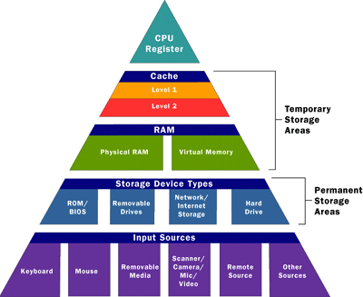
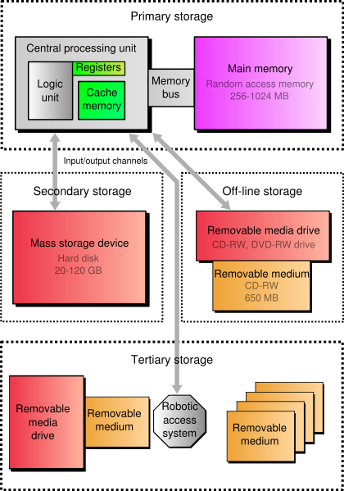
Memory :

Slide 5
Memory Structure
Memory
Non Volatile
Volatile
ROM
RAM
PROM
Static
EPROM
EEPROM
Dynamic
FLASH
Hard-Disk, CD, DVD, Floppy Disk, Magnetic Tape, USB Flash memory, SD Card
Notes:
PROM
EPROM
EEPROM

Slide 6
RAM

Slide 7
Semiconductor Memory
RAM
Misnamed as all semiconductor memory is random access
Types of RAM:
RAM generally store a bit of data in either the state of a flip-flop, as in SRAM (static RAM), or as a charge in a capacitor (or transistor gate), as in DRAM (dynamic RAM)
Read/Write
Volatile
Temporary storage
Static or dynamic

Slide 8
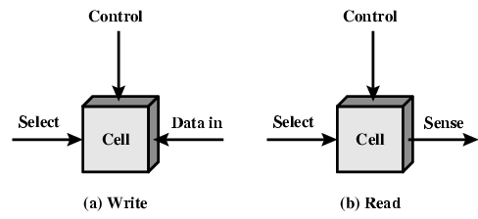
Memory Cell Operation

Slide 9
Dynamic RAM
Bits stored as charge in capacitors
Charges leak
Need refreshing even when powered
Simpler construction
Smaller per bit
Less expensive
Need refresh circuits
Slower
Main memory
Essentially analogue
Level of charge determines value

Slide 10
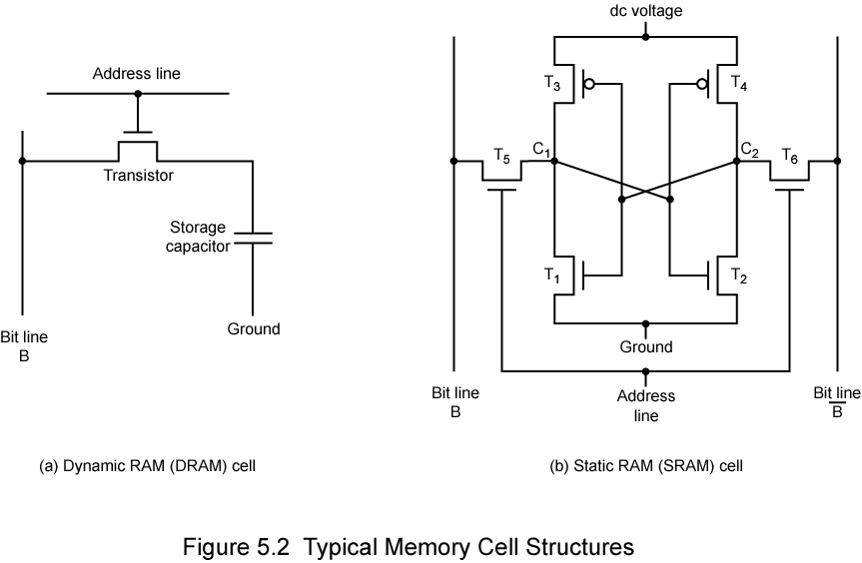
Dynamic RAM Structure

Slide 11
DRAM Operation
Address line active when bit read or written
Transistor switch closed (current flows)
Write
Voltage to bit line
High for 1 low for 0
Then signal address line
Transfers charge to capacitor
Read
Address line selected
transistor turns on
Charge from capacitor fed via bit line to sense amplifier
Compares with reference value to determine 0 or 1
Capacitor charge must be restored

Slide 12
Static RAM
Bits stored as on/off switches
No charges to leak
No refreshing needed when powered
More complex construction
Larger per bit
More expensive
Does not need refresh circuits
Faster
Cache
Digital
Uses flip-flops

Slide 13
Stating RAM Structure

Slide 14
SRAM vs DRAM
Both volatile
Power needed to preserve data
Dynamic cell
Simpler to build, smaller
More dense
Less expensive
Needs refresh
Larger memory units
Static
Faster
Cache

Slide 15
ROM

Slide 16
Read Only Memory (ROM)
Permanent storage
Nonvolatile
Microprogramming
Library subroutines
Systems programs (BIOS)
Function tables

Slide 17
Non-volatile
Electrically Addressed
ROM
PROM
EAROM
EPROM
EEPROM
Flash memory

Slide 18
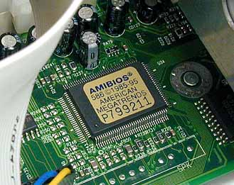
ROM Read-only memory
Stored-program computer requires some form of non-volatile storage to store the initial program that runs when the computer is powered on or otherwise begins execution (a process known as bootstrapping, often abbreviated to "booting" or "booting up")
Read-only memory (ROM), also known as firmware, is an integrated circuit programmed with specific data when it is manufactured. ROM chips are used not only in computers, but in most other electronic items as well.

Slide 19
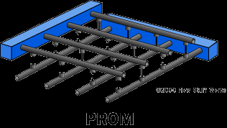
PROM Programmable Read Only Memory
Programmable read-only memory (PROM) or field programmable read-only memory (FPROM) is a form of digital memory where the setting of each bit is locked by a fuse or antifuse. Such PROMs are used to store programs permanently. The key difference from a strict ROM is that the programming is applied after the device is constructed.
Creating ROM chips totally from scratch is time-consuming and very expensive in small quantities. For this reason, mainly, developers created a type of ROM known as programmable read-only memory (PROM). Blank PROM chips can be bought inexpensively and coded by anyone with a special tool called a programmer.
Advantages
Reliability
Stores data permanently
Moderate price
Built using integrated circuits, rather than discrete components.
Fast: speed is between 35ns and 60ns.
Notes:
PROM chips have a grid of columns and rows just as ordinary ROMs do. The difference is that every intersection of a column and row in a PROM chip has a fuse connecting them. A charge sent through a column will pass through the fuse in a cell to a grounded row indicating a value of 1. Since all the cells have a fuse, the initial (blank) state of a PROM chip is all 1s. To change the value of a cell to 0, you use a programmer to send a specific amount of current to the cell. The higher voltage breaks the connection between the column and row by burning out the fuse. This process is known as burning the PROM.
PROMs can only be programmed once. They are more fragile than ROMs. A jolt of static electricity can easily cause fuses in the PROM to burn out, changing essential bits from 1 to 0. But blank PROMs are inexpensive and are great for prototyping the data for a ROM before committing to the costly ROM fabrication process.

Slide 20
EPROM Erasable Programmable Read Only Memory
It is an array of floating-gate transistors individually programmed by an electronic device that supplies higher voltages than those normally used in electronic circuits. Once programmed, an EPROM can be erased only by exposing it to strong ultraviolet light.
Erasable programmable read-only memory (EPROM) addresses this issue. EPROM chips can be rewritten many times. Erasing an EPROM requires a special tool that emits a certain frequency of ultraviolet (UV) light. EPROM's are configured using an EPROM programmer that provides voltage at specified levels depending on the type of EPROM used.
EPROM's are easily recognizable by the transparent fused quartz window in the top of the package, through which the silicon chip can be seen, and which permits UV light during erasing.
Notes:
Once again we have a grid of columns and rows. In an EPROM, the cell at each intersection has two transistors. The two transistors are separated from each other by a thin oxide layer. One of the transistors is known as the floating gate and the other as the control gate. The floating gate's only link to the row (wordline) is through the control gate. As long as this link is in place, the cell has a value of 1. To change the value to 0 requires a curious process called Fowler-Nordheim tunneling. Tunneling is used to alter the placement of electrons in the floating gate. An electrical charge, usually 10 to 13 volts, is applied to the floating gate. The charge comes from the column (bitline), enters the floating gate and drains to a ground.
This charge causes the floating-gate transistor to act like an electron gun. The excited electrons are pushed through and trapped on the other side of the thin oxide layer, giving it a negative charge. These negatively charged electrons act as a barrier between the control gate and the floating gate. A device called a cell sensor monitors the level of the charge passing through the floating gate. If the flow through the gate is greater than 50 percent of the charge, it has a value of 1. When the charge passing through drops below the 50-percent threshold, the value changes to 0. A blank EPROM has all of the gates fully open, giving each cell a value of 1.
To rewrite an EPROM, you must erase it first. To erase it, you must supply a level of energy strong enough to break through the negative electrons blocking the floating gate. In a standard EPROM, this is best accomplished with UV light at a frequency of 253.7. Because this particular frequency will not penetrate most plastics or glasses, each EPROM chip has a quartz window on top of it. The EPROM must be very close to the eraser's light source, within an inch or two, to work properly.
An EPROM eraser is not selective, it will erase the entire EPROM. The EPROM must be removed from the device it is in and placed under the UV light of the EPROM eraser for several minutes. An EPROM that is left under too long can become over-erased. In such a case, the EPROM's floating gates are charged to the point that they are unable to hold the electrons at all.

Slide 21
EEPROM Electrically Erasable Programmable Read Only Memory
EEPROMs:
In circuit programmable: The chip does not have to removed to be rewritten.
The entire chip does not have to be completely erased to change a specific portion of it unlike in EPROM’s.
Changing the contents does not require additional dedicated equipment.
There are different types of electrical interfaces to EEPROM devices. Main categories of these interface types are :
Serial bus
Parallel bus
Notes:
Serial bus devices
Most common serial interface types are SPI, I²C and 1-Wire. These three interfaces require between 2 and 4 controls signals for operation, resulting in a memory device in an 8 pin (or less) package.
The serial EEPROM typically operates in three phases: OP-Code Phase, Address Phase and Data Phase. The OP-Code is usually the first 8-bits input to the serial input pin of the EEPROM device (or with most I²C devices, is implicit); followed by 8 to 24 bits of addressing depending on the depth of the device, then data to be read or written.
Each EEPROM device typically has its own set of OP-Code instructions to map to different functions. Some of the common operations on SPI EEPROM devices are:
Write Enable (WREN)
Write Disable (WRDI)
Read Status Register (RDSR)
Write Status Register (WRSR)
Read Data (READ)
Write Data (WRITE)
Other operations supported by some EEPROM devices are:
Program
Sector Erase
Chip Erase commands
Parallel bus devices
Parallel EEPROM devices typically have an 8-bit data bus and an address bus wide enough to cover the complete memory. Most devices have chip select and write protect pins. Some microcontrollers also have integrated parallel EEPROM.
Operation of a parallel EEPROM is simple and fast when compared to serial EEPROM, but these devices are larger due to the higher pin count (28 pins or more) and have been decreasing in popularity in favor of serial EEPROM or Flash.

Slide 22
Semiconductor Memory : Summary
Memory Type | Category | Erasure | Write Mechanism | Volatility
Random-access memory (RAM) | Read-write memory | Electrically, byte-level | Electrically | Volatile
Read-only memory (ROM) | Read-only memory | Not possible | Masks | Nonvolatile
Programmable ROM (PROM) |  |  | Electrically
Erasable PROM (EPROM) | Read-mostly memory | UV light, chip-level
Electrically Erasable PROM (EEPROM) |  | Electrically, byte-level
Flash memory |  | Electrically, block-level

Slide 23
Semiconductor Memory : Summary
Written during manufacture
Very expensive for small runs
Programmable (once)
PROM
Needs special equipment to program
Read “mostly”
Erasable Programmable (EPROM)
Erased by UV
Electrically Erasable (EEPROM)
Takes much longer to write than read
Flash memory
Erase whole memory electrically

